Slide 1
Microservices

Slide 2
Azure
microservices
serverless
Cloud
Docker
Image
Container
Service Principal
ARM templates
kubctl
API management
swagger
VMSS
AKS
Monitor
Identity
PowerShell
API

Slide 3
Microservices
Microservices - also known as the microservice architecture - is an architectural style that structures an application as a collection of services that are
Highly maintainable and testable
Loosely coupled
Independently deployable
Organized around business capabilities
Owned by a small team
The microservice architecture enables the rapid, frequent and reliable delivery of large, complex application as a collection of small autonomous services, modeled around a business domain.

Slide 4
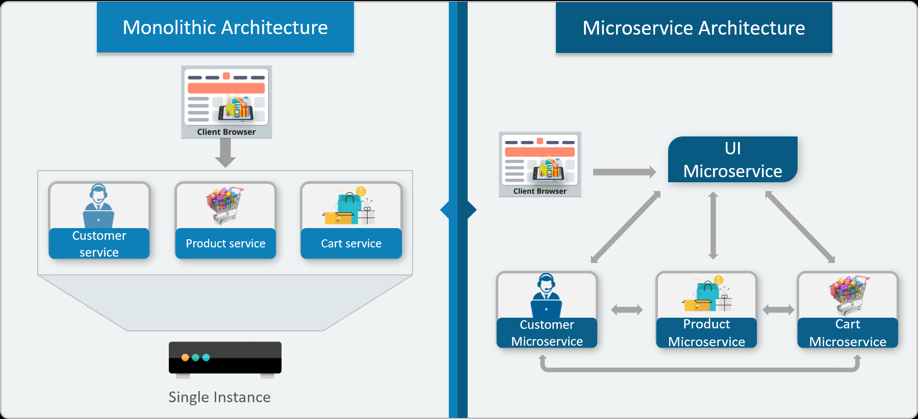
In Microservice Architecture, each service is self-contained and implements a single business capability.
Consider an E-commerce application as a use-case to understand the difference between both of them.

Slide 5
WHY SHOULD WE USE MICROSERVICES INSTEAD OF A MONOLITHIC APPROACH?
Microservices are smaller in size
Microservices are easier to develop, deploy, and debug, because a fix only needs to be deployed onto the microservice with the bug, instead of across the board
Microservices can be scaled quickly and can be reused among different projects
Microservices work well with containers like Docker
Microservices are independent of each other, meaning that if one of the microservices goes down, there is little risk of the full application shutting down

Slide 6
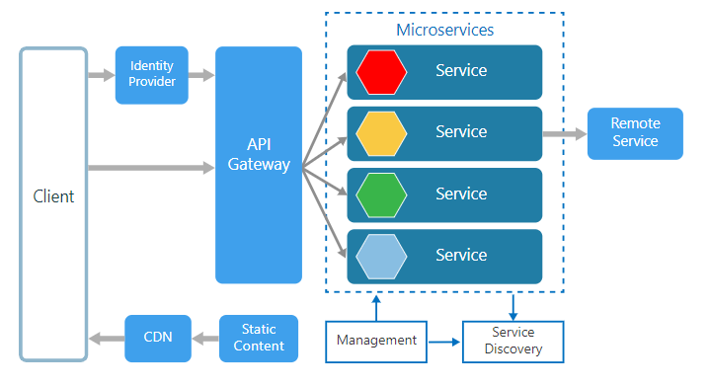
Microservices architecture style

Slide 7
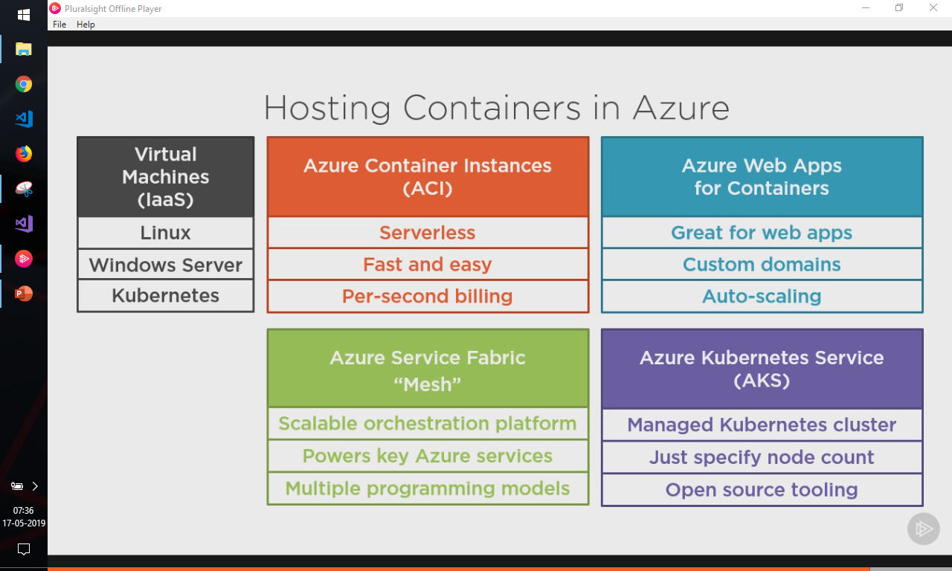

Slide 8
In a microservices architecture, services are small, independent, and loosely coupled.
Each service is a separate codebase, which can be managed by a small development team.
Services can be deployed independently. A team can update an existing service without rebuilding and redeploying the entire application.
Services are responsible for persisting their own data or external state. This differs from the traditional model, where a separate data layer handles data persistence.
Services communicate with each other by using well-defined APIs. Internal implementation details of each service are hidden from other services.
Services don't need to share the same technology stack, libraries, or frameworks.

Slide 9
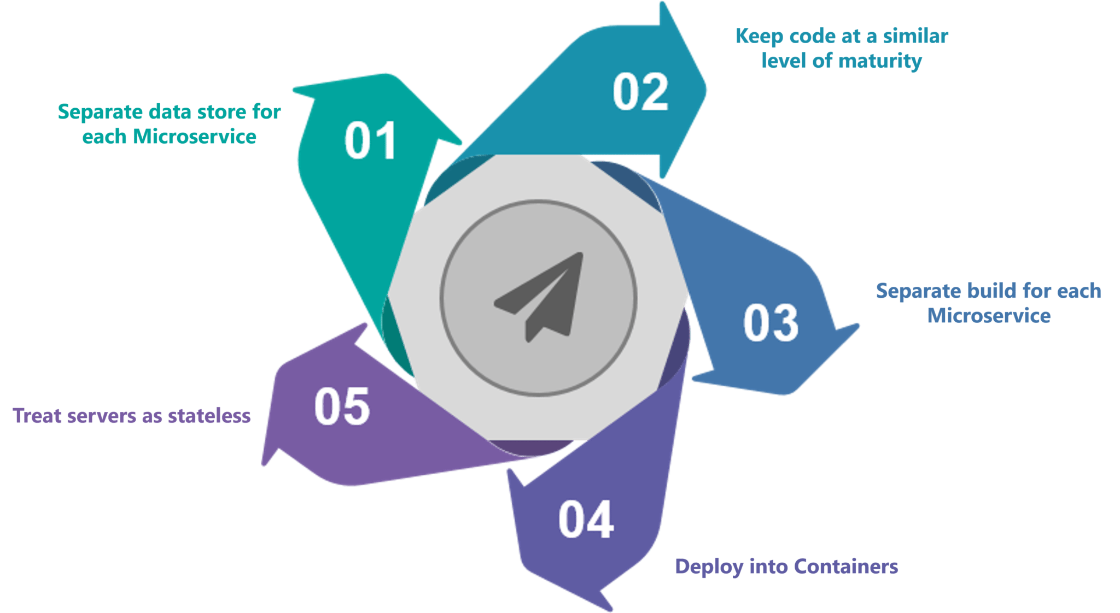
Best Practices To Design Microservices

Slide 10
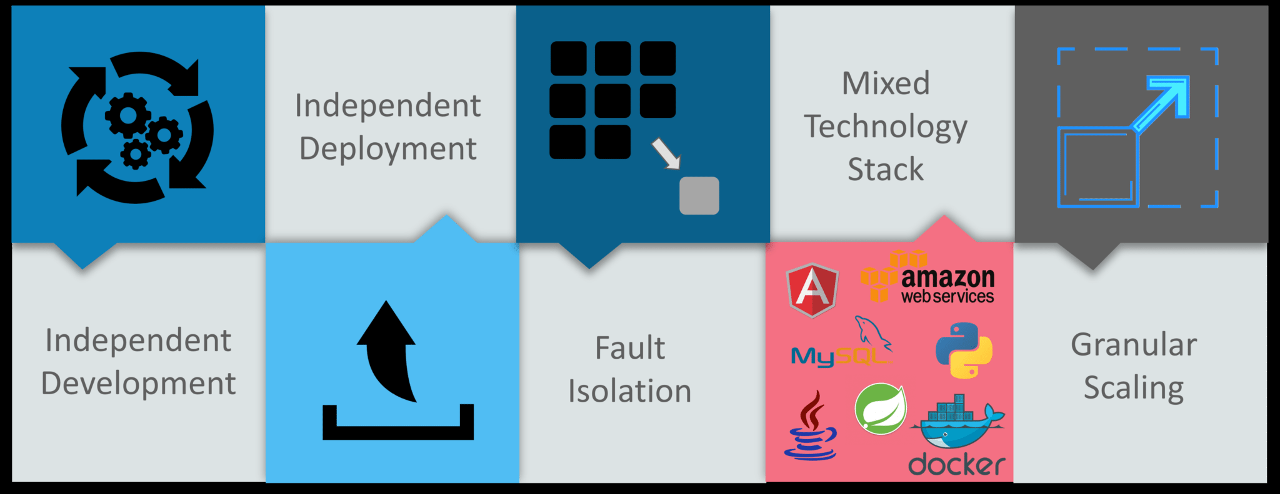

Advantages Of Microservices

Slide 11
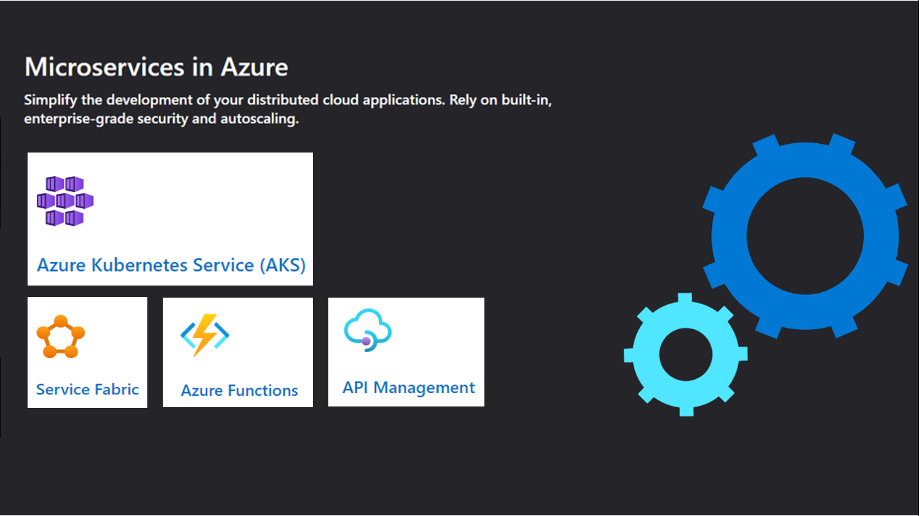

Slide 12
Azure Kubernetes Service (AKS) makes it simple to deploy a managed Kubernetes cluster in Azure. AKS reduces the complexity and operational overhead of managing Kubernetes by offloading much of that responsibility to Azure. As a hosted Kubernetes service, Azure handles critical tasks like health monitoring and maintenance for you. The Kubernetes masters are managed by Azure. You only manage and maintain the agent nodes. As a managed Kubernetes service, AKS is free - you only pay for the agent nodes within your clusters, not for the masters.
You can create an AKS cluster in the Azure portal, with the Azure CLI, or template driven deployment options such as Resource Manager templates and Terraform. When you deploy an AKS cluster, the Kubernetes master and all nodes are deployed and configured for you.

